Slide 1
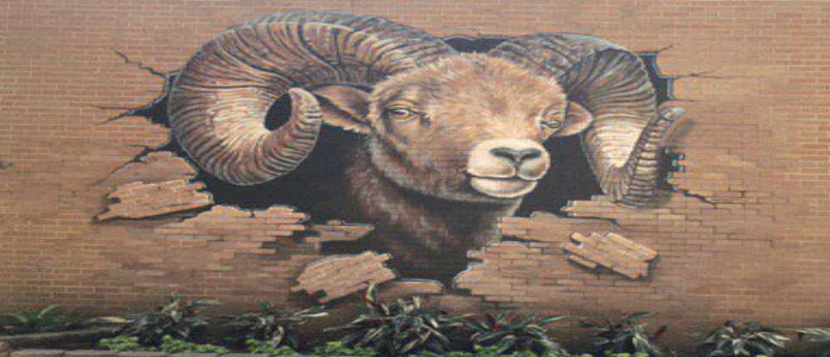
T. H. Rogers 2024 – 2025 K – 8 Vanguard Program
Principal:
Tiffany Chenier
Assistant Principals:
Gregory Wagner
Jessica Willie Beaulieu
Magnet Coordinator:
Barbra Hearne
Counselor:
Bradley Evans
Teacher Specialist:
Steven Ghorbanian
“Where Academics and
Character Matter”

Slide 2
What to Expect:
PowerPoint Presentation
Q & A
School Tour (breakout into 2 groups Elementary and Middle School)

Slide 3
Magnet vs. Vanguard Magnet
Magnet Schools – specializes in a particular theme (fine arts, health sciences, STEM, etc.).
Vanguard Magnet School – specializes in Gifted and Talented (GT) identified students with accelerated instruction.

Slide 4
TX Education Code 89.3
Requires all public schools in Texas to provide services to GT identified students.

Slide 5
In HISD
Services are handled one of four ways:
1. Pull-outs (usually elementary)
2. Blended classes (has both GT and non -GT students)
3. Homogeneous classes (all GT)
4. HISD Advanced (Formerly Pre-AP / IB or AP middle
and high school)

Slide 6
What about THR?
We are a Vanguard Magnet with NO zoned students.
All students K – 8th are GT Identified.
All core classes are taught by GT Certified Teachers.
All Middle School core classes (math, science, English, and social studies) are HISD Advanced (formerly labeled Pre-AP level).

Slide 7
How do I get in?
To attend THR’s Vanguard Program:
The student must apply to the program.
The student must qualify as GT, if not already labeled.
The student must be selected in the HISD Magnet Lottery.

Slide 8
Why choose THR?

Slide 9
Elementary Curriculum:
Departmentalized K through 5th Grades (teachers teach to their passion)
Four teachers per grade level with a two-way team teach; students rotate between the two classes:
English Language Arts/Reading/Social Studies
Math/ Science
(opportunities for students to experience
varied learning styles)

Slide 10
Elementary Homework
You should expect 15 to 75 minutes
… every night …

Slide 11
Middle School Curriculum
All Core Classes are HISD Advanced (formerly called Pre-AP)
High School Credit (Algebra, Art, Geometry, Fundamentals of Computer Science, IPC, Foreign Language, etc.) (not automatic must audition or test into)
Traditional Block Schedule. Alternate between A & B Days

Slide 12
Middle School Homework
You should expect 1 to 3 hours
… every night …

Slide 13
Is it all work?
Elementary:
Art
Chess
Computer
STEM (Project Based Learning)
Music
Orchestra
P.E.
Name That Book
Spelling Bee
Jr. Student Council
Middle School:
Name That Book
Chess
Drama & Speech
Exploratory Science
Digital Media
Math Counts/ Math Club
Orchestra
Scholastic Writing
Quiz Bowl
Student Council (StuCo)
National Juniors Honor Society (NJHS)
Baseball, Volleyball, Swim, Track, Cross Country, and Basketball, Soccer & Cheer

Slide 14
What Makes THR different?
All students in our program are labeled GT, all teachers are GT certified!
Our Vanguard program is intensely focused on Academics!

Slide 15
What else?
540 VG Elementary Students
471 VG Middle School Students
We Do Not have a school uniform
Very active

Slide 16
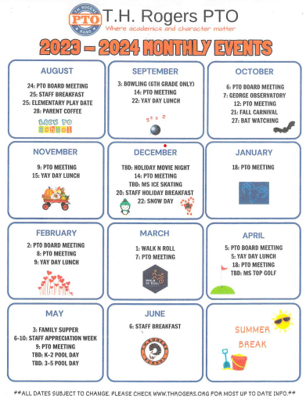

Slide 17
Elementary Space Available:
88 Spaces for Kindergarten
0 Spaces for 1st, 2nd, 3rd, and 4th grades (based purely on attrition)
12 Spaces for 5th grade (currently 88 in 4th we add 12 more to make it 100 in 5th).

Slide 18
But if there are no spaces …
Why do you accept applications?
Because movement happens
(Occasionally, students transfer out, move over the summer)

Slide 19
Middle School Space Available:
50-60 Spaces for 6th Grade
10-15 Spaces for 7th
10-15 spaces for 8th grade

Slide 20
Let’s Go Over Testing …

Slide 21
Testing Information
Deadline for Vanguard Magnet applicants to request G/T testing:
December 8, 2023
NOTE: Vanguard Magnet applicants that are NOT G/T-identified in HISD must request G/T testing!!

Slide 23
IMPORTANT TESTING INFORMATION Deadline to REQUEST Testing 12/8
Entering Kinder Testing: | Dates for testing include: December 2, 2023 December 9, 2023 December 16, 2023 January 13, 2024
How do I request testing: | Visit the link that pertains to your student’s grade level.
Automatic Testing: | 2nd grade students only who are not already GT identified. Oct. 9 – Oct. 20, 2023
Testing for 1st, 3rd, 4th, 5th, 6th, 7th and 8th. | You MUST request!! Window: Nov. 13 – Dec. 16
Assessments Taken: | Achievement and Ability
Results/Qualification: | Enrolled campus/ 1st Choice Vanguard Campus
Retesting: | Only once per year

Slide 24
What about Documents?
Entering Kindergarten:
parent recommendation
birth certificate
HISD:
teacher recommendation
report card 1st grade and up
Non-HISD:
report card
teacher recommendation for ALL grades.
If you have additional questions about documents,
email your highest ranked Vanguard school

Slide 25
PoR Warning
You must currently live within the boundaries of the Houston Independent School District when you apply to T. H. Rogers or your application will not be processed.

Slide 26
The Importance of Ranks
Your child will have an equal chance in all school lotteries to which you apply, and to which they have qualified to attend.
Ranks are important *AFTER* the lotteries have been run.
Schools are ranked by the order you list them.

Slide 27
Ranks and the Lottery:
Rank | Programs Applied To: | Lottery Outcome: | What Parents See:
Rank 1 | School A | Wait Listed | Wait Listed #
Rank 2 | School B | Wait Listed | Wait Listed #
Rank 3 | School C | Accepted | Accepted
Rank 4 | School D | Accepted | ** Dropped **
Rank 5 | School E | Accepted | ** Dropped **

Slide 28
What the Parent will See:
Rank | Programs Applied To: | What Parents See:
Rank 1 | School A | Wait List #
Rank 2 | School B | Wait List #
Rank 3 | School C | Accepted

Slide 29
Your Choice :
Rank | Programs Applied To: | What Parents See:
Rank 1 | School A | Wait List #
Rank 2 | School B | Wait List #
Rank 3 | School C | Accepted
Accept the seat at School C.
Decline the seat at School C.
You will no longer have accept offers from multiple schools.

Slide 30
To Be Clear …
The order of the ranks are the order in which you apply to schools. (First application is Rank 1, second application is Rank 2, and so on).

Slide 31
To be Absolutely Clear …
The system defaults to the highest ranked school to which your child both qualified and was accepted.
Be *VERY SURE* you have your schools ranked how you want them by the deadline.

Slide 32
Important Lottery Info:
The online system runs each magnet school lottery separately.
What happens in one lottery has absolutely nothing to do with any other school’s lottery.
Sibling preference is given in Kinder and 6th Grades only!

Slide 33
Reminders:
The ranks will default to the highest accept.
You will never see what happened in the lottery for lower ranked schools that have dropped off your list.

Slide 34
What are the odds?
We truly have no idea!
Every year, “the odds” depends on a few things: How many applicants total? How many qualified as GT? How many spaces we have available for that grade level?

Slide 35
Remember:
In order to attend T. H. Rogers:
You must apply to T. H. Rogers.
Your student must be qualified as GT.
Your student must be selected in THR’s lottery.

Slide 36
Our one guarantee:
If you do not apply, you will not get into THR!

Slide 37
The Application

Slide 38
School of Choice
Website:
https://choosehisd.my.site.com/Apply/SiteLanding
Phone:
713.556.6947

Slide 39
1 Application per School
You must fill out an application for each school to which you wish to apply!

Slide 40
Time
The first application takes 20 to 30 minutes.
Subsequent applications take about 1 minute.
Remember: the order is important!
Do not forget to hit the submit button!!

Slide 41
Honestly …
You should apply to more than one school, we suggest you apply to 5 schools, the maximum allowed.

Slide 42
Hot Spots:
Transportation!
Bilingual / ESL (LEP) – this is asking if your student is labeled 504. If you say yes, you have to provide documentation!
If your student is new to HISD they are more than likely NOT labeled!

Slide 43
Hot Spots:
Sharing a Lottery Number: it only applies to twins / triplets / quads / etc.
Please Note: you should only click this if you have twins / triplets / quads / etc. applying and you want them to share a lottery number. (creating multiple applications can backfire).

Slide 44
Deadlines
APPLICATIONS: | OPEN: January 2024
DOCUMENTS: | ASAP!
LOTTERY: | April 2024

Slide 45
Q&A…
1. Call our Vanguard office: 713.917.3570.
2. Email: Ms. Hearne at: bhearne@houstonisd.org,
Ms. Hardy at:
LHARDY1@houstonisd.org, or
Ms. Buirse at:
Asia.Buirse@houstonisd.org.

Slide 46
Thank you for your time and consideration!
From the students, faculty, and staff of T. H. Rogers!

